Slide 1
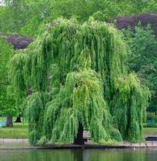
Ph.D. Defense Non-Rigid Image Alignment for Object Recognition
Olivier Duchenne

Slide 2
Thanks

Slide 3
Motivation

Slide 4
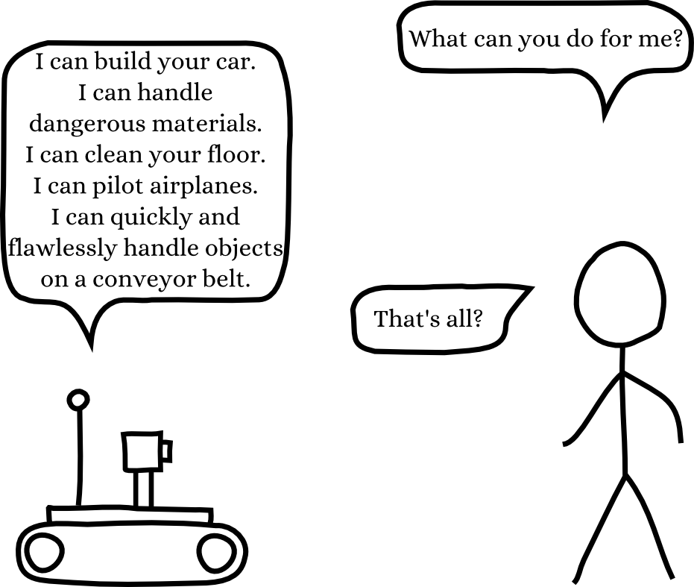

Slide 5
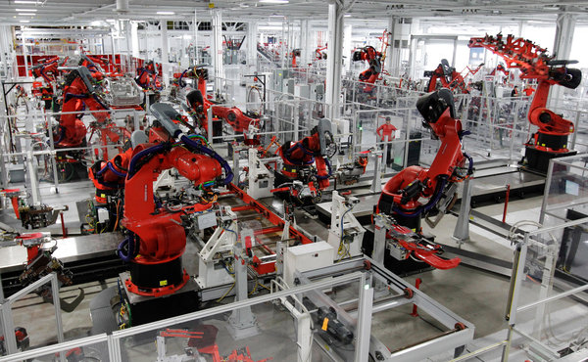
Engineers carefully segment the work into small tasks that do not require any knowledge about the environment of the robot

Slide 6
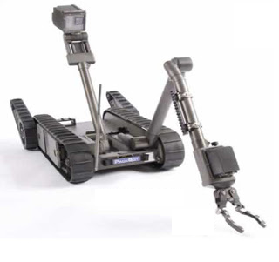
Remote-Controlled Robot

Slide 8
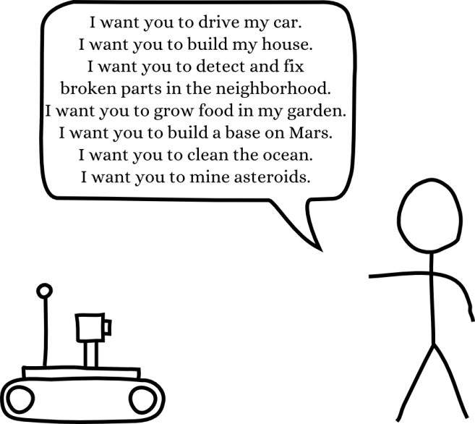

Slide 9
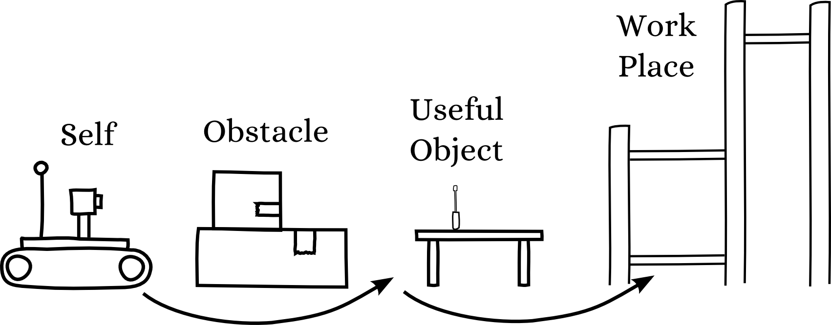
Increasing the Set of Possible Tasks
Information about environment is required to perform a complex task autonomously, in an unknown environment.

Slide 10
Computer Vision
The Science to algorithmically gather as much information as possible from images and videos.
Hard enough to require intelligent algorithm
Easy enough to not leave us in the dark
Solvable
Easy to benchmark

Slide 11
The Object Recognition Problem
The computer should recognize objects of a learned category.
One way to do that is to recognize that the seen image (test image) is similar to a previously seen image (train image), and infer that the seen object is from the same category that the object in the stored (and labeled) image.
I have already seen that before…

Slide 12
We need to build a similarity measure
≈
?

Slide 13
In many other computer fields, we know in advance where are the matching parts.
Moreover, parts are matching if they are exactly equal.

Slide 14
The Mis-Alignment Problem
In vision, the computer does not know in advance where are the matching/corresponding parts.
This makes it hard to compare images.

Slide 15
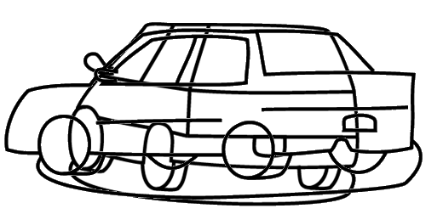
Global Non-Rigid Deformation
Due to viewpoint change, intra-class variation, we do not have global alignment.

Slide 16
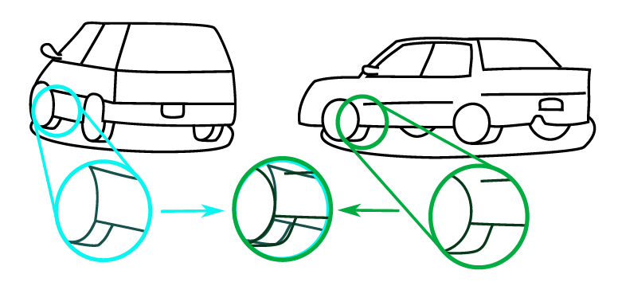
Local Rigidity

Slide 17
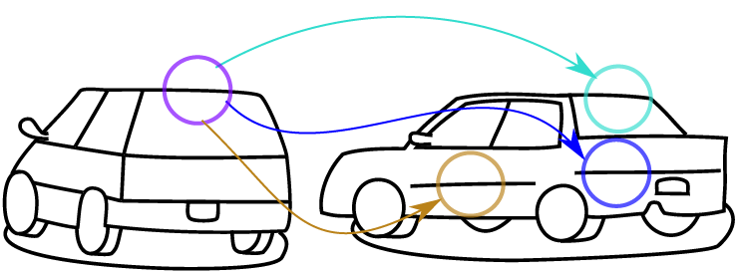
The local ambiguity
Locally, different parts can look similar.

Slide 18
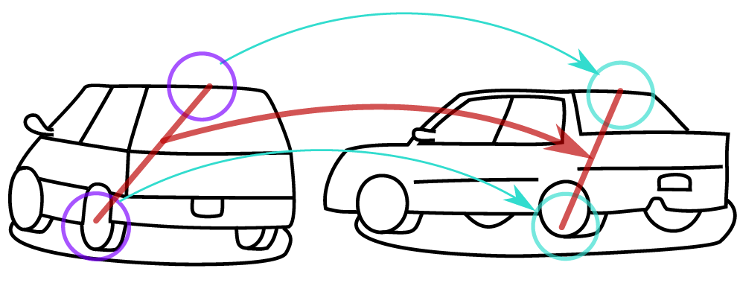
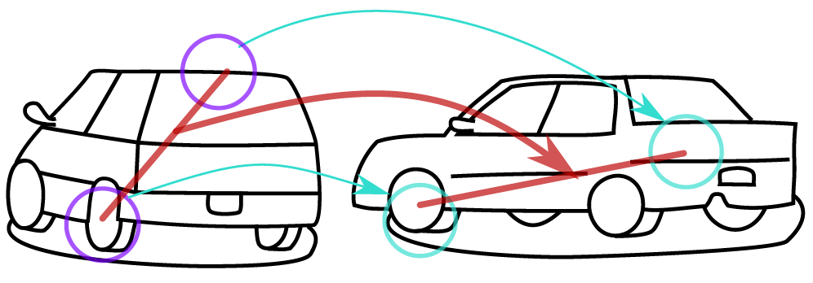
Pair-Wise Geometric Information Can Help
In both cases, matching nodes have similar local appearance.
GOOD
Same pair-wise geometric relationship
BAD
Different pair-wise geometric relationship

Slide 19
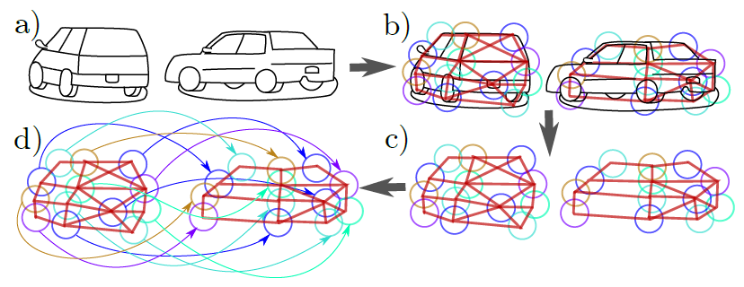
Graph Matching

Slide 20
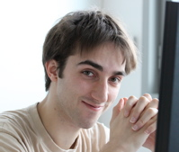
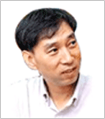
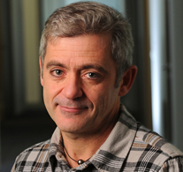
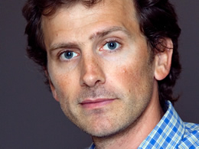
Chapter I
A Tensor-Based Algorithm for High-Order Graph Matching
Olivier
Duchenne
Francis
Bach
In-So
Kweon
Jean
Ponce

Slide 21
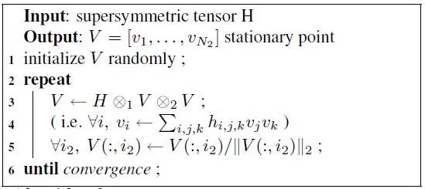
Contributions
Extension of [Leordeanu & Hebert] to the case of hypergraph.
1) Tensor Formulation and Power Method
2) Sparse output for the relaxed matching problem.

Slide 22
Previous Works
Generic Graph Matching Problem

Slide 23
Previous Works
Generic Graph Matching
NP-Hard combinatorial problem.
Wide and active literature existing on approximation algorithms.
Greedy
Relaxed formulation
Convex-concave optimization
Many others…
[1] M. Zaslavskiy, F. Bach and J.-P. Vert. PAMI, 2009.
[2] D. C. Schmidt and L. E. Druffel. JACM, 1976.
[3] J. R. Ullmann. JACM, 1976.
[4] L. P. Cordella, P. Foggia, C. Sansone, and M. Vento. ICIAP, 1991.
[5] Shinji Umeyama. PAMI, 1988.
[6] S.Gold and A.Rangarajan. PAMI, 1996.
[7] Hong Fang Wang and Edwin R. Hancock. PR, 2005.
[8] Terry Caelli and Serhiy Kosinov. PAMI 2004.
[9] H.A. Almohamad and S.O.Duffuaa. PAMI, 1993.
[10] C.Schellewald and C.Schnor. LNCS, 2005.

Slide 24
Previous Works
Objective function
(
)
.
.
.
m1
(
)
.
.
.
m2
First order score
Second order score
[1] A. C. Berg, T. L. Berg, and J. Malik. CVPR 2005.
[2] M. Leordeanu and M. Hebert. ICCV 2005.
[3] T. Cour and J. Shi. NIPS 2006.

Slide 25
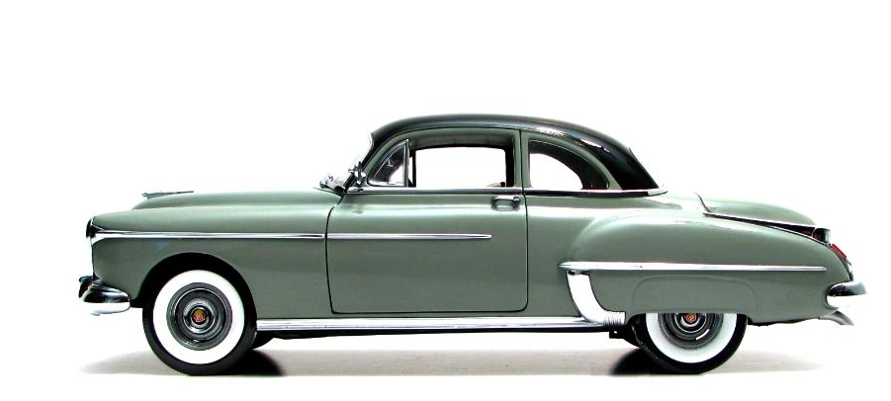
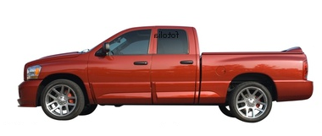
Hypergraph Matching Problem
How graph matching enforces
geometric consistency?
[1] A. C. Berg, T. L. Berg, and J. Malik. CVPR 2005.

Slide 26
Hypergraph Matching Problem
How graph matching enforces
geometric consistency?
[1] A. C. Berg, T. L. Berg, and J. Malik. CVPR 2005.
[2] M. Leordeanu and M. Hebert. ICCV 2005.

Slide 27
Hypergraph Matching Problem
How to improve it?

Slide 28
Hypergraph Matching Problem
How to improve it?

Slide 29
Hypergraph Matching Problem
Hypergraph Matching
A hyper-edge can link more than 2 nodes at the same time.
[1] Ron Zass and Amnon Shashua. CVPR, 2008

Slide 30
Hypergraph Matching Problem
Formulation

Slide 31
Hypergraph Matching Problem
Relaxation
Constraints:
Relaxed constraints:
Main
Eigenvector
Problem
Each node is matched to at most one node.
[1] M. Leordeanu and M. Hebert. ICCV 2005.

Slide 32
Hypergraph Matching Problem
Hypergraph Matching
H

Slide 33
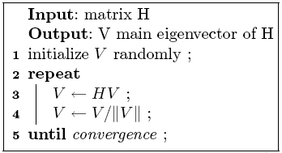
Hypergraph Matching Problem
Power Method
The power method can efficiently find the main eigenvector of a matrix.
It can efficiently use the sparsity of the Matrix.
It is very simple to implement.

Slide 34
Hypergraph Matching Problem
Tensor Power Iteration
Converge to a local optimum (of the relaxed problem)
Always keep the full degree of the hypergraph (never marginalize it in a frist or second order)
[1] L. De Lathauwer, B. De Moor, and J. Vandewalle. SIAM J. Matrix Anal. Appl., 2000
[2] P. A. Regalia and E. Kofidis. ICASSP, 2000

Slide 35
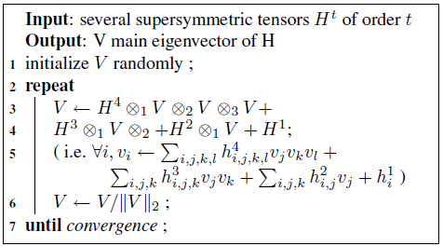
Hypergraph Matching Problem
Tensor Power Iteration
It is also possible to integrate cues of different orders.

Slide 36
Sparse Output
Sparse Output

Slide 37
Implementation
Compute descriptors for all triplets of image 2.
Same for a subsample of triplets of image 1.
Use Approximate Nearest Neighbor to find the closest triplets.
Compute the sparse tensor.
Do Tensor Power Iteration.
Projection to binary solution.

Slide 38
Experiments
Artificial cloud of point.
We generate a cloud of random points.
Add some noise to the position of points.
Rotate it.

Slide 39
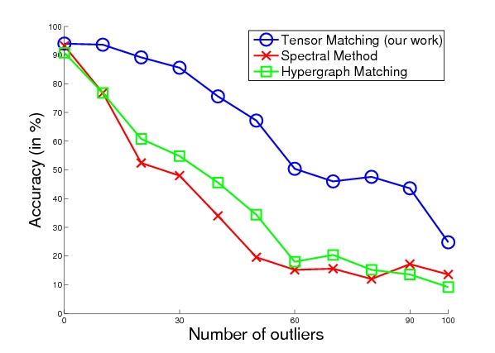
Experiments
Accuracy depending on outliers number
Our work
Leordeanu & Hebert
Zass & Shashua

Slide 40
Experiments
Accuracy depending on scaling
Our work
Leordeanu & Hebert
Zass & Shashua

Slide 41
Experiments
CMU hotel dataset
[1] CMU 'hotel' dataset: http://vasc.ri.cmu.edu/idb/html/motion/hotel/index.html

Slide 42
Experiments
Error on Hotel data set
Our work
Zass & Shashua
Leordeanu & Hebert

Slide 43
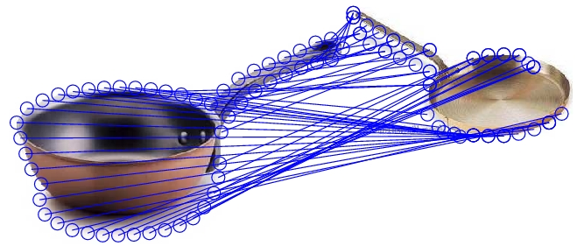
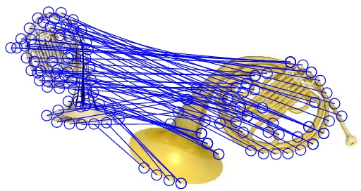
Experiments
Examples of Caltech 256 silouhettes matching

Slide 44
Chapter Conclusion
Method for Hyper-Graph matching.
Tensor formulation
Power Iteration
Sparse output

Slide 45
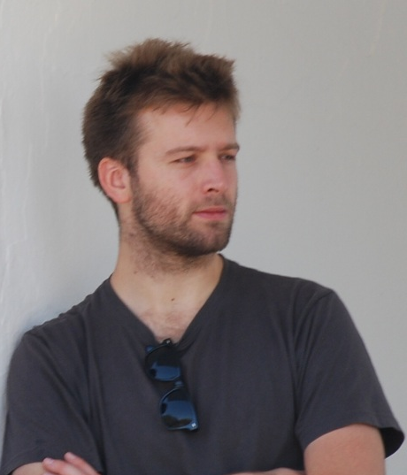
Chapter II A Graph-Matching Kernel for Object Categorization
Olivier
Duchenne
Armand
Joulin
Jean
Ponce

Slide 46
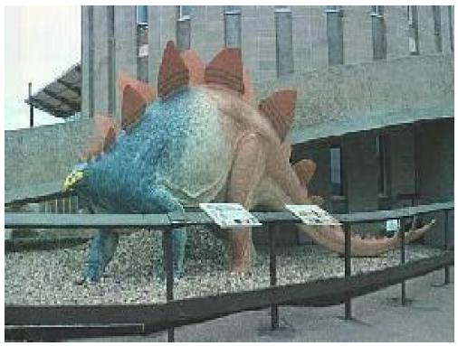
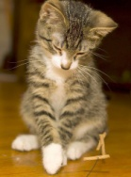
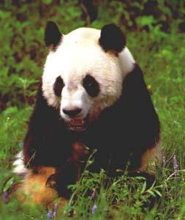
Goal: Object Categorization
DINOSAUR
CAT
PANDA

Slide 47
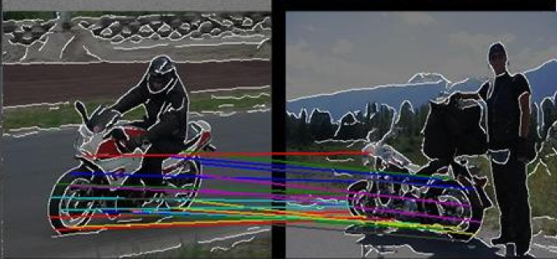
Graph Matching
[1] A. C. Berg, T. L. Berg, and J. Malik. CVPR05
[2] M. Leordeanu and M. Hebert. ICCV05

Slide 48
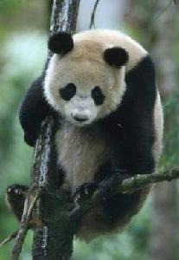
Feature Matching
Caputo (2004)
Boiman, Shechtman & Irani (2008)
Caputo & Jie (2009)

Slide 49
Graph Matching
Nevatia & Binford’72
Fischler & Elschlager’73
Berg, Berg, & Malik’05
Leordeanu & Hebert’05
Cour & Shi’08
Kim & Grauman’10
Etc.

Slide 50
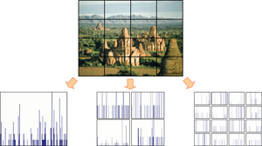
Graph Matching
Spatial Pyramids
VS
Approximate Feature Matching
Does not take into account pair-wise relationship
Require quantization
Low Computational Coast
Graph Matching
Take into account pair-wise relationship
Does not require quantization
High Computational Coast

Slide 51
So, how does it perform in real life?
Graph-Matching keeps more information, but is much slower…
In addition, it appears to perform much worse than SPM kernel.
Caltech 101 (%)
Graph Matching Based Methods | 15 examples
Berg Matching [CVPR 2005] | 48
GBVote [Berg phD thesis] | 52
Kim et Graumann [CVPR 2010] | 61
Spatial Pyramid Methods
Boureau et al. [CVPR10] | 69.0
Yang et al.[ICCV09] | 73.3

Slide 52
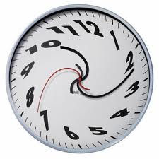
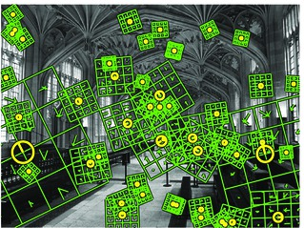
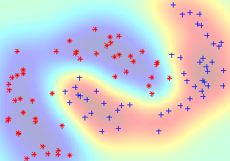
Graph Matching
Spatial Pyramids
VS
Dense Features
SVM classifier
Fast
No pair-wise
Information
State-of the-Art
performance
Sparse Features
NN Classifier
Slow
Use pair-wise
Information
Lower performance

Slide 53
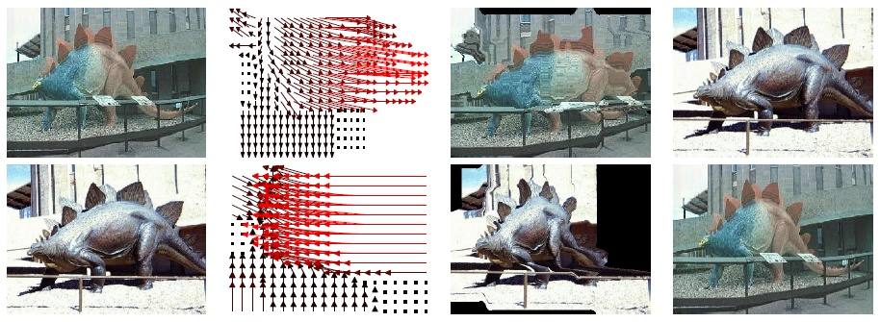
Our Approach
Spatial Pyramids
VS
Dense Features
SVM classifier
Fast
No pair-wise
Information
State-of the-Art
performance
As Dense
SVM Classifier
Fast enough
Use pair-wise
Information
State-of-the-art performance

Slide 54
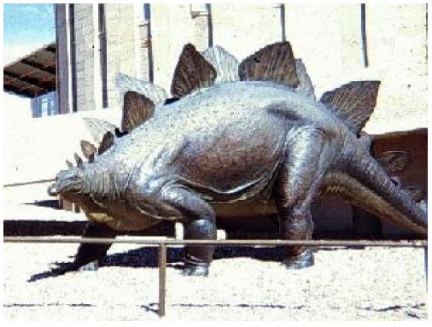
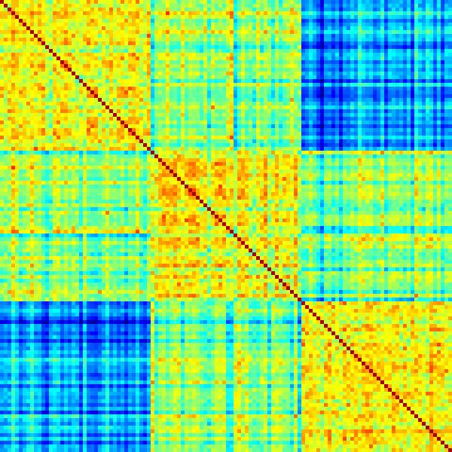
Outline of our method
Image j
Image i
K(Im_{i},Im_{j})
As Dense
SVM Classifier
Fast enough
Use pair-wise
Information
State-of-the-art performance
K=
Not Definite Positive
Notes:
Our goal is to make a similarity measure based on graph matching, that we will be used as an SVM kernel
So we will compare each pair of training images.
So we need something very fast
Our kernel is not definite-positive, so we truncate the negative eigenvalues.
1vsAll SVM

Slide 55
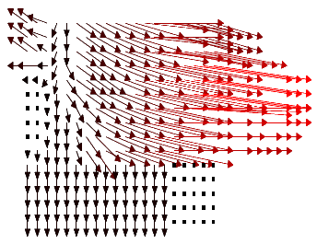
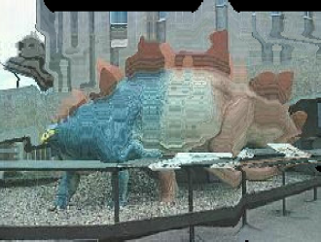
≈
?

Slide 56
Similarity
Sum of Local Similarities
≈
?
Deformation Smoothness
Maximized over all possible deformations

Slide 57
In our case: we allow each point to match to a 11x11 grid in the other image.
Notes:
For each node in the first image we want to assign a node in the second image.
Or equivalently, we will assign a displacement:
The displacement of the node in position (y,x) in the first image is denoted by:
d_{y}(y,x), d_{x}(y,x)

Slide 58
Unary term

Slide 59
Binary term
GOOD

Slide 60
Binary term
BAD

Slide 61
Binary term II
VERY BAD

Slide 62
Optimization problem
Minimize with respect to the integer disparity vector d:
This is (in general) an NP-hard problem…
…because there is no natural ordering on the vectors d
We give an efficient approximation algorithm

Slide 63
Vertical Move
The general problem is NP Hard, but if we just allow vertical moves, it can be solved optimally.

Slide 64
Horizontal Move
Horizontal moves can also be solved optimally.

Slide 65
Diagonal Move
Diagonal moves can also be solved optimally.

Slide 66
General Move
If all points move in the same direction (e.g. d_{x} increasing d_{y} decreasing), it can also be solved optimally.
The allowed moves can be different for each point, as long as they are in the same direction.

Slide 67
Optimization
Even if the whole optimization is NP hard, for each of the sub-problems (horizontal move,…) we can find the global optimum.
To optimize our objective function, we iterate over the different types of move, until convergence.
We can do it using Ishikawa’s method.

Slide 68
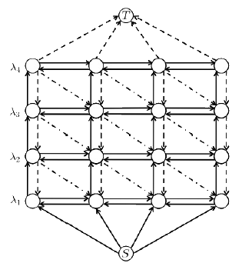
Optimization method
Ishikawa’s method can solve:
with
with g convex, and the labels mapped on integer.

Slide 69
Comparison with alpha-expansion
Alpha Expansion: At each iteration, each node can choose between keeping its label, or taking the label alpha.
Ours: At each iteration, each label can chose between K (=11) labels.
At convergence, the local minimum is better than its n neighbors:
Alpha Expansion:
Ours:
Total number of configurations:

Slide 70
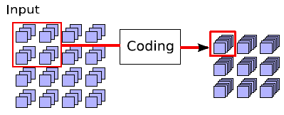
Summary
Extract Features
Global Normalization
Match pairs of images
Make a kernel from matching scores
Train 1vsAll SVM
Test with SVM

Slide 71
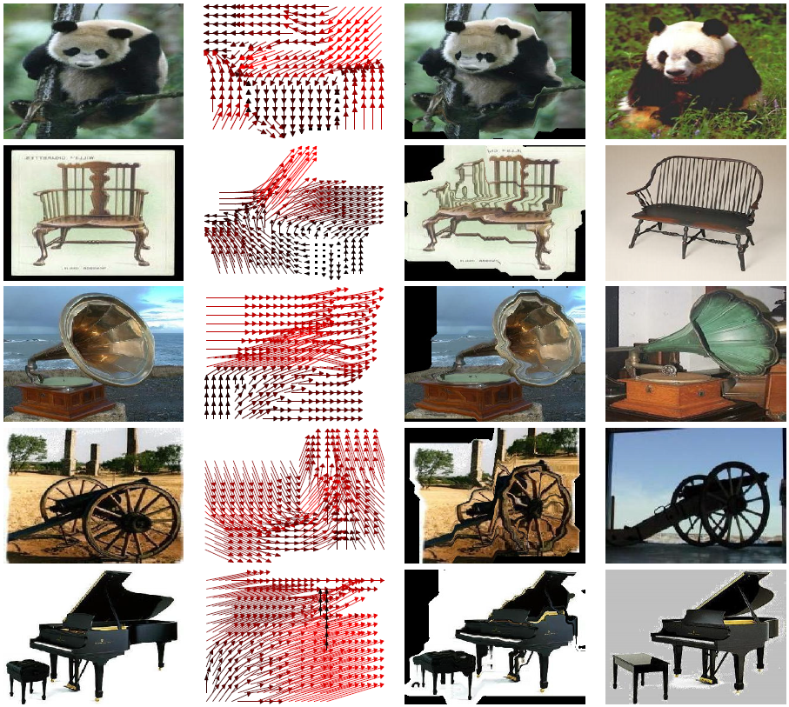

Slide 72
Results for Graph Matching methods
Caltech 101 (%)
Graph Matching Based Methods | 15 examples
Berg Matching [CVPR 2005] | 48
GBVote [Berg PhD thesis] | 52
Kim and Graumann [CVPR 2010] | 61
Ours | 75.3
+14%

Slide 73
Results: Caltech 101
Caltech 101 (%)
Feature | Method | 15 examples | 30 examples
Single | NBNN (1 Desc.) [CVPR08] | 65.0 | -
 | Boureau et al. [CVPR10] | 69.0 | 75.7
 | Ours | 75.3 | 80.3
+6%
+5%
Multiple | Gu et al.[CVPR09] | - | 77.5
 | Gehler et al.[ICCV09] | - | 77.7
 | NBNN (5 Desc.)[CVPR08] | 72.8 | -
 | Yang et al.[ICCV09] | 73.3 | 84.3
Notes:
Our implementation uses the same features than Boureau et al. [CVPR10], replacing spatial pyramids by our matching method.
We can see a clear improvement of performance (+6%).
This tends to show that geometric relationships between patches contains useful information.

Slide 74
Results: Caltech 256
Caltech 256 (%)
Feature | Method | 30 examples
Single | SPM+SVM[07] | 34.1
 | Kim et al. [CVPR10] | 36.3
 | NBNN (1 desc.) | 37.0
 | Ours | 38.1
Multiple | NBNN (5 Desc.)[CVPR08] | 42.0

Slide 75
Matching Time
Method | Number of Nodes | Time
Berg el al.[CVPR 05] | 50 | 5s
Leordaenu et al.[ICCV 05] | 130 | 9s
Kim , Grauman[CVPR10] | 4800 | 10s
Kim, Grauman[CVPR 10] | 500 | 1s
Alpha-Expansion | 500 | 1s
TRW-S | 500 | 10s
Ours | 500 | 0.04s
Notes:
Cost for matching 2 images

Slide 76
Chapter Conclusion
Graph-matching can make good performance
It is more interpretable, and it makes it easy to visualize what is happening.
Our main contributions are: the combination of SVM and graph matching; and the design of a fast matching algorithm.

Slide 77
Chapter III Image Alignment for Object Detection
Submitted to
Olivier
Duchenne
Jean
Ponce

Slide 78
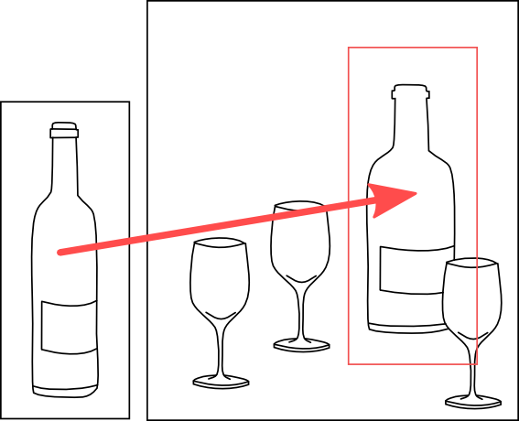
Goal 1: Matching Template to Test Image

Slide 79
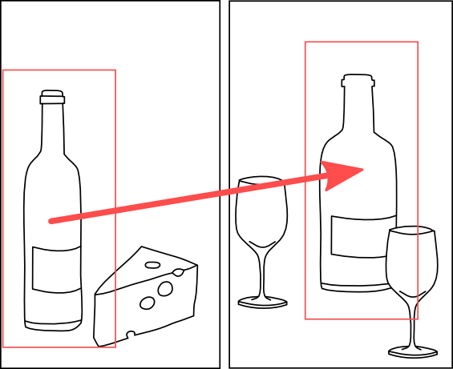
Goal 2: Finding the Most Similar Pair

Slide 80
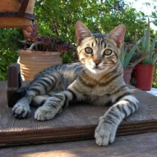
Summary of the method
We want to find the most similar bounding boxes …

Slide 81
…by finding the most similar pairs of movable subparts…

Slide 82
…and each subpart can move around its anchor point, with a maximum distance...

Slide 83
…with densely sampled parts.

Slide 84
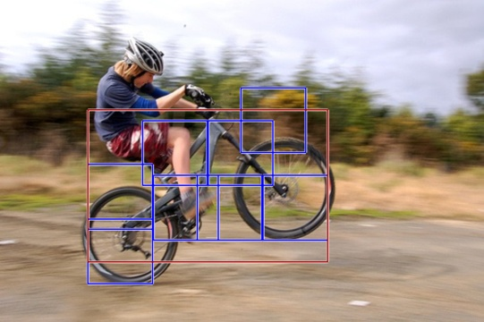
Deformable Part Model

Slide 85
Matching with All Parts

Slide 86
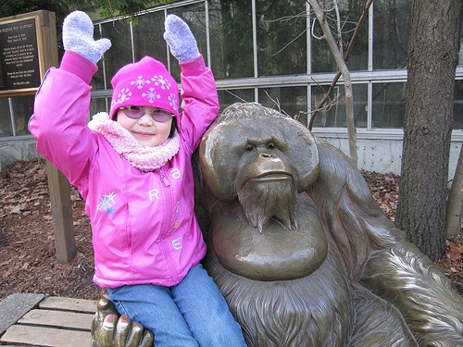
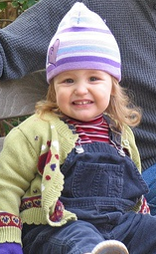
Model, with immobile sub-parts.
The method finds the best match in the test image.

Slide 87
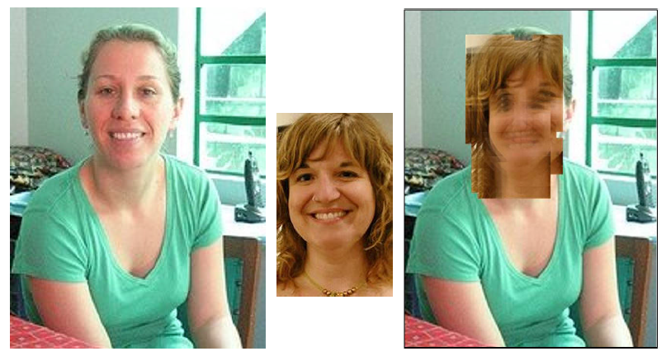
Real World Example

Slide 88
Scale Choice
Rough scale
- Loss of Discriminative Power
+ Less Mis-Alignment Issue
Fine Scale
- Mis-Alignment Issue
+ More Discriminative Power

Slide 89
In the Object categorization case,
the number of possible matching nodes for a given node was reasonable.

Slide 90
Detection Case
Since, we do not know where is the object in the other image, we have to take into account much more possible matching nodes.
This increases the optimization search space. So, it becomes much harder to find a reasonable local minimum in reasonable time.

Slide 91
The new things I am working on now
Let’s say we have two images
We want to do co-detection.

Slide 92
Method explanation
To simplify, let’s say that our images are 1D
Comparing all sliding windows can be done by a convolution with a diagonal kernel.
Local feature similarity matrix
Sliding window 1
I₁
I₁
I₂
Sliding window 2
I₂
Can be done in linear time with integral image.

Slide 93
Adding Movable Parts
Comparing all sliding windows with deformable sub-parts can be done by a max-convolution and the previous convolution.
Sub-part similarity matrix
Sliding window 1
I₁
I₁
I₂
I₂
Sliding window 2

Slide 94
Using All Parts
By taking all the possible sub-parts, the computation time becomes linear.
Sub-part similarity matrix
Sliding window 1
I₁
I₁
I₂
I₂
Sliding window 2

Slide 95
Hierarchical Model
We can have deep tree structures, by alternating convolution and max-convolution.
Sliding window 1
I₁
I₂
Sliding window 2

Slide 96
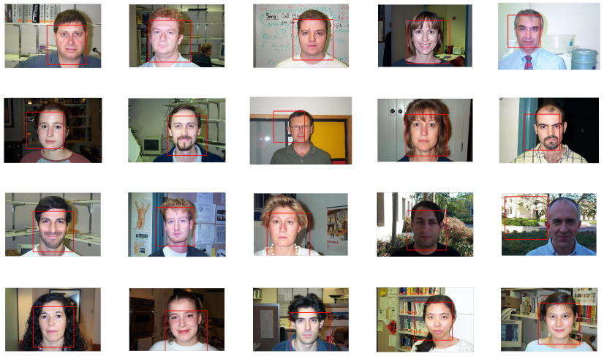
Proof of concept: co-detection

Slide 97
Learning Models for Detection
Or method is a mixture between E-SVM and L-SVM.
We train one model per training sample, with it as the only positive exemplar.
We consider the deformation as a latent variable, and use latent SVM.
[1] Felzenswalb et al, 2008
[2] Malisiewicz et al, 2011

Slide 98
The Training Highlights Discriminative Parts
Before Training (original sample)
After Training (used at test time)

Slide 99
Before Training (original sample)
After Training (used at test time)

Slide 100
Some Results

Slide 102
Quantitative Results on Pascal VOC 2007

Slide 103
Other Works

Slide 104
Other Works

Slide 105
General Conclusion
Many thanks to my advisor.
Many thanks to the jury.

